Slide 1
Revolutionary Sustainable Environmentally Friendly European production of Press Rolled® Barrel Nipples
Brand New
Sustainable
Environmental
Friendly
Production
Worldwide patented
Highest quality nipples ever. Earthquake resistant.
Competitive pricing Fast delivery from EU

Slide 2
Press Rolled is Worldwide Patented!®
Exclusive Dealer/Agent for Europe:
FittingsEurope The Netherlands

Slide 3
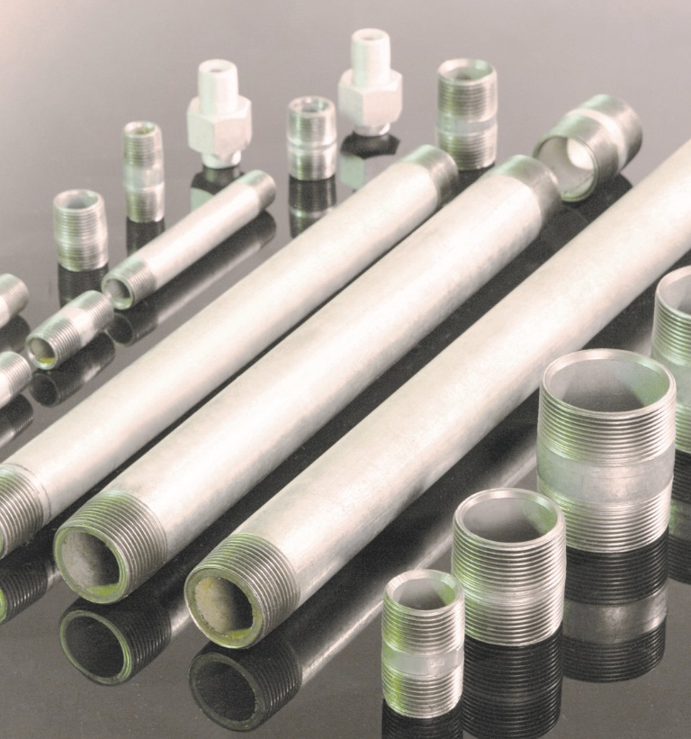
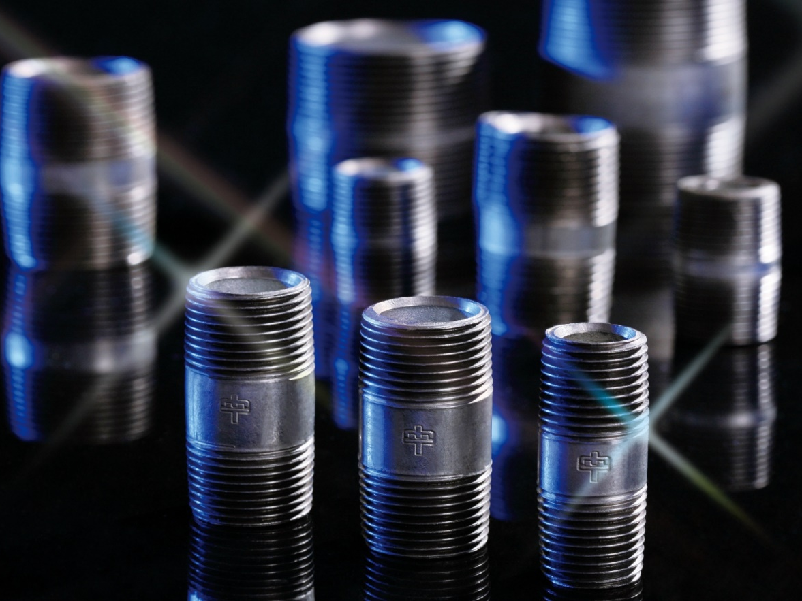
Fittings Europe
The Netherlands
Press Rolled® Galvanized & Black Barrel Nipples

Slide 4
Revolutionary Automatic
Press Rolling
Old Cutting method
hover your mouse over the images
to see our video’s.

Slide 5
SIX ADVANTAGES of
PRESS ROLLED® Barrel NIPPLE

Slide 6
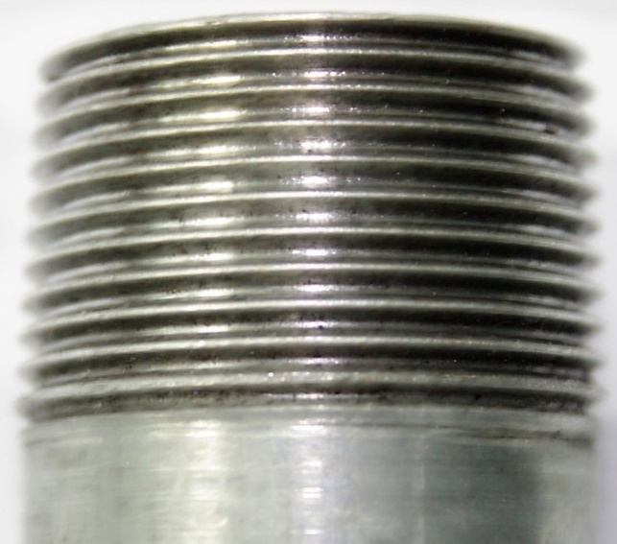
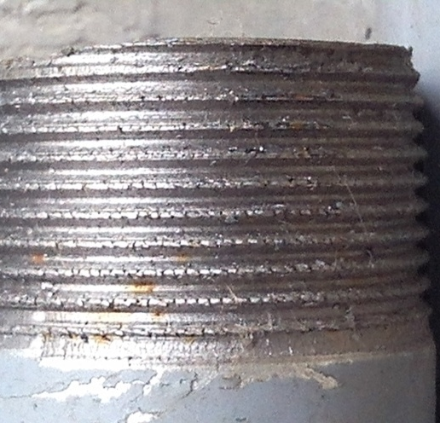
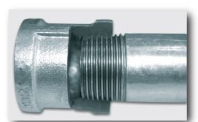
1st Increased Resistance to Leakage
Much better surface roughness on thread and 100% perfect thread tooth profile at full length of the thread greatly improve the matching between male and female threads, which reduces leaking possibilities with lathe cut nipples.
Zinc coatings remain intact plays “hard metal sealant” role enhancing mating of male and female threads, together with traditional “soft tape” sealant.
No metal is removed, which enhances the mechanical properties and provides a stronger, more reliable, and safer pipe connection during vibration of the piping system.
Rolled
Cut

Slide 7
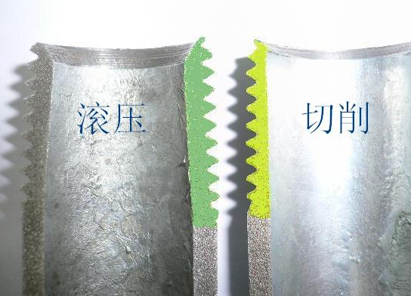
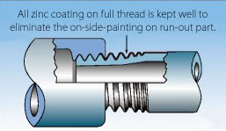
2nd Increased Rust Protection & Increase Durability
Rolled
Cutting
Original zinc coatings are not "cut away" as with lathe cut nipples.
Press Rolled® (compressed-formed) thread increases the “thickness” & the density of the thread tooth.
Original zinc coatings remain intact with higher density of our Press Rolled® Thread Nipples which increases, no doubt, its life, strength and durability.
Rolled
Cut

Slide 8
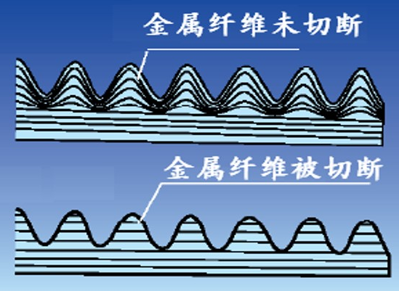
3rd Safety & Improved Earthquake-Resistant strength
Heat generated by lathe cut threads along with tooling, cuts and tears at the metal, thus diminishing the pipes original strength. Lathe cut threads tear at the bottom of the "v" grove and vary with tooling wear.
Press Rolled® Thread Technology adds strength to the metal product. Increases bending strength, Increases tensile strength, Increases surface hardness. It is stronger than the original pipe itself.
Our Press Rolled® Thread Technology produces a uniform thread formation adding 40% - 60% to the thread groove, adding strength and eliminating loose fit, sediment build-up at starter threads, drift and lateral displacement of the piping under stress.
Rolled thread tooth cross-section
Cut thread tooth cross-section

Slide 9
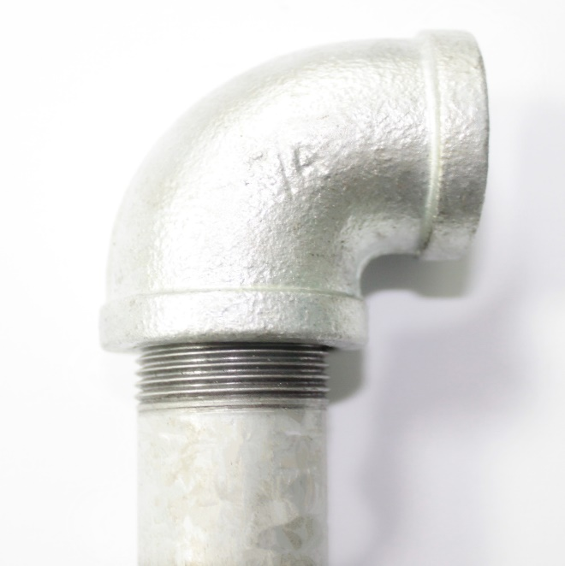
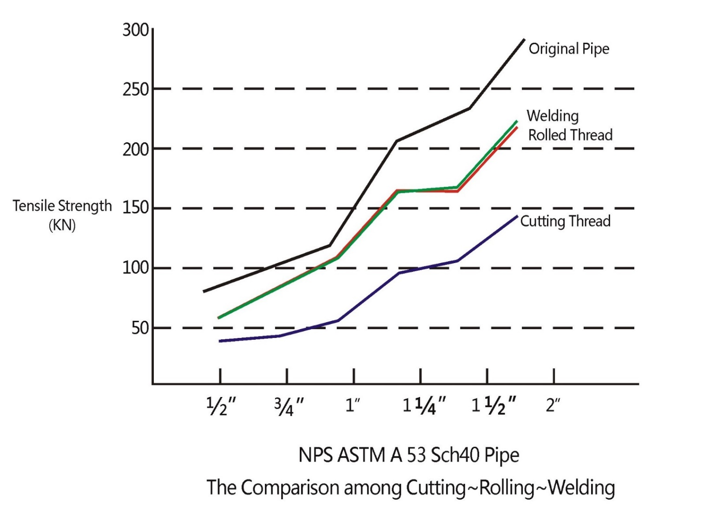
Press Rolled® Thread Pipe Connection is as strong as pipe welding!
Safety & Improved Earthquake-Resistant strength

Slide 10
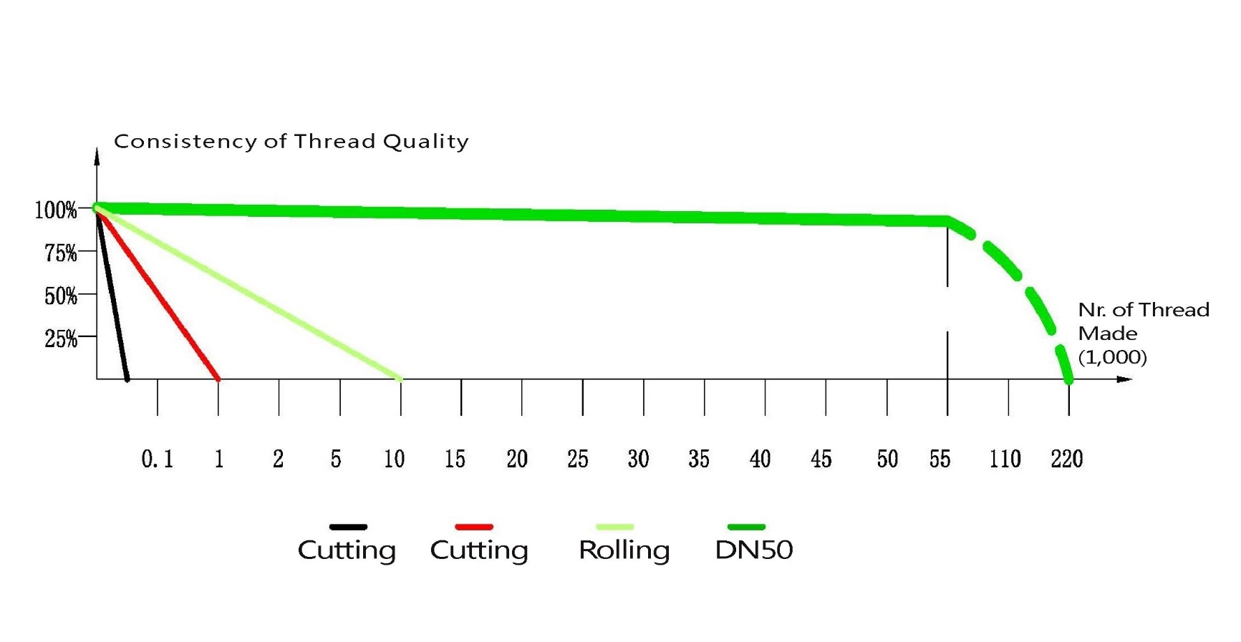
4th High Quality at Low Cost
CPK values of rolled threads are greatly increased, Lower Labor costs to install:
Reduced friction decreases installation time and call backs to re-tighten.
Zinc coatings remain intact during threading offering greater, long term protection.
Pipe sealant and tape requirements are reduced greatly on different size pipe connection.
All zinc coating on full thread is well kept to eliminate the on-side-painting on run-out part.
Both ends having the same concentricity helps easy and fast installation.

Slide 11
5th Increased Working Pressures
(CThread) Press Rolled® Barrel Nipples offer increased working pressures within any pipe network.
Press Rolled® Thread Technology Pipe Connection will be as strong as the pipe itself.
Schedule 40 RTN can replace “Schedule 80” cutting thread Nipples and so on.
FittingsEurope
Dutch Pipe Fittings BV
Marterkoog 7B,1822BK, Alkmaar, The Netherlands
sales@fittingseurope.com
Tel: +31613256766

Slide 12
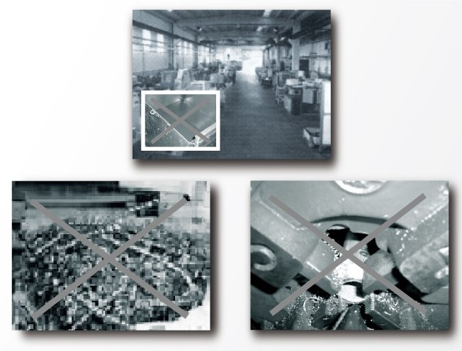
6th Sustainable Environmentally
Friendly Production!
Unlike waste by-products produced by outdated thread cutting machinery, Press Rolled® thread machinery does not generate shavings or scrap waste.
Waste from thread cutting fluids is significantly reduced with Press Rolled® thread technology.
The global benefits of our patented Press Rolled® Thread Technology will include increased working pressure capabilities, reduced leakage, decreased material usage, minimized installation labor force requirements, and the potential to replace pipe welding.

Slide 13
Press Rolled® steel Barrel Nipple is one of your best choices.
Press Rolled® is precise, consistent, stronger, coating kept, & as good as the original pipe itself.
Press Rolled® Barrel Nipple technologies make a small but significant contribution to a sustainable planet.
Dutch Pipe Fittings BV
Marterkoog 7B, 1822BK, Alkmaar-The Netherlands
sales@fittingseurope.com
www.fittingseurope.com

Slide 14
FittingsEurope (Dutch Pipe Fittings BV) has significant experience in Barrel Nipple production. Our innovative, patented press rolling® technologies create trouble-free barrel nipples.
-SUSTAINABLE and environmentally manufacturing process. We reduce environmental impact by minimizing production cooling oil usage and eliminating metal waste. We utilize at least 30% renewable energy in our production process.
-EU production no anti-dumping taxes, minimizes environmental impact by reducing sea freight in order to further our sustainability.
-Fast Deliveries from Europe.
-Faster installation
-Fewer callbacks
-Saving on labor costs.
-More reliable anti-leakage properties
-Better tensile strength during high tensile constructions.
-longer lifespan compared to traditional pipe connections.
-Significant costs saving
-Substitute for steel pipe weld connections high installation efficiency and zero carbon emissions during pipeline construction.

Slide 15
Exclusive dealer for Europe:
FittingsEurope
Dutch Pipe Fittings BV
Marterkoog 7B, 1822BK, Alkmaar, The Netherlands
sales@fittingseurope.com
www.fittingseurope.com

